Slide 1


Slide 2
Data Science
Explosion of data
Big Data
Analyzing and Deriving Value

Slide 3
Apps
Search Engines – algorithm -> best search result
Targeted Advertising – gather data based on user’s past behavior
Recommendations – Amazon (similar products), Netflix (shows), LinkedIn, etc.
Image Recognition – facial reco

Slide 4
Apps
Speech recognition
Gaming – ML + Data -> game levels up based on player’s performance
Fraud and Risk Detection – banks
… and MORE!

Slide 5
Machine Learning
Give “computers the ability
to learn without being explicitly programmed.”
- Arthur Samuel

Slide 6
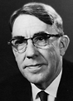
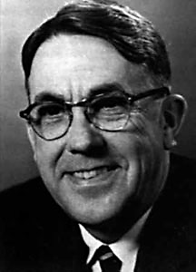
Machine Learning #CoinedBy
Arthur Samuel

Slide 7
Apps
Medical – IBM developed an algorithm that combs through physicians free-form text notes and using NLP, figure out if the patient has heart failure
Recommendations
Natural Language Processing (NLP) – routing in customer service or translating legal docs.
Smart Cars

